Slide 1
Signal Processing & Data Science
“From Signal To Knowledge”
June 2017

Slide 2
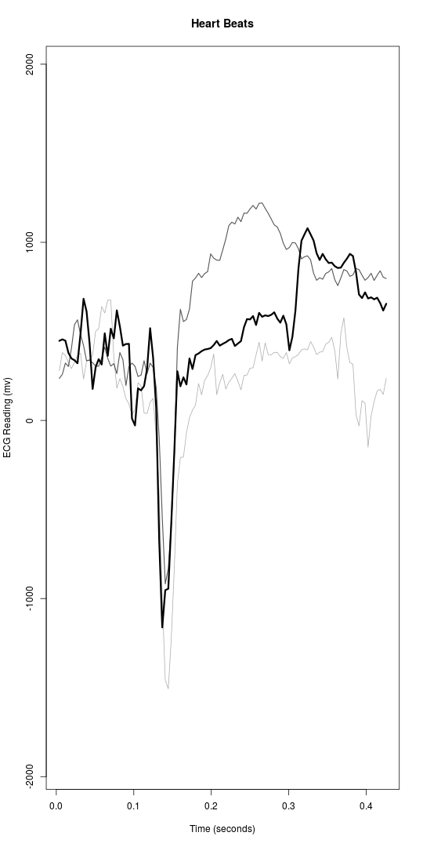

Slide 3
Here Is The Problem
New ‘Non-Contact’ Sensors Can Capture ECG Signals Through Layers of Fabric or Remotely
The sensors are not in direct contact with the subject
The sensors may not be optimally located on the subject
The subject may be in motion.
Traditional signal processing approaches do not work
Motion artifacts distort ECG signals
Capacitively coupled signals are subject to baseline drift.
New signal processing techniques are needed!

Slide 4
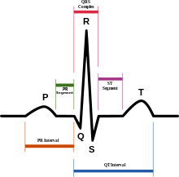
Heart Rate Variability
Heart Rate Variability, HRV, is the measurement of the time intervals from one R peak to the next R peak
HRV as an indicator: risk of impending cardiac event, fitness, arrhythmias, stress levels, etc.
t
t
t
Del Rey’s objective to provide accurate HRV measurements in challenging environments.

Slide 5
Del Rey vs. Pan-Tompkins A Comparison
Pan-Tompkins is the industry standard for sensor-based QRS detection algorithms
Originally formulated in the early 1970’s by Rautaharju and Simoons for exercise ECGs
Refined and published by Pan and Tompkins in 1985
Designed for clinical contact leads with saline paste
Pan-Tompkins is not sufficient for non-contact sensor applications

Slide 6
Pan-Tompkins Vs. Del Rey Analytics
In these slides we show you:
Pan-T vs. Del Rey algorithms processing data sets captured from
Plessey non-contact sensors, and thumb-to-thumb sensors
Non-contact exercise ECG samples
Non-contact seat sensors in an electric car
Pan-Tompkins algorithm via Mathworks
Del Rey software is written in R

Slide 7
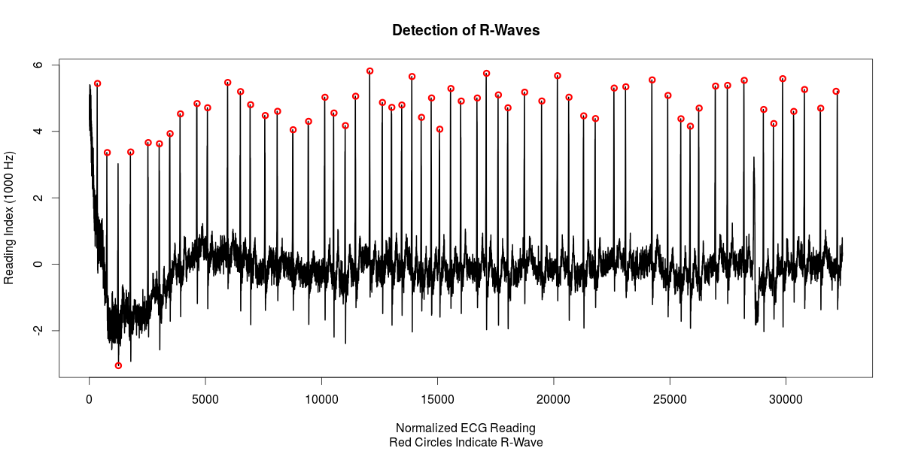
Pan-Tompkins QRS Detection Fails On Clean Segment Due To Improper Handling Of High Energy Noise Bursts
Pan-Tompkins
Pan-Tompkins detector
Del Rey Detector

Slide 8
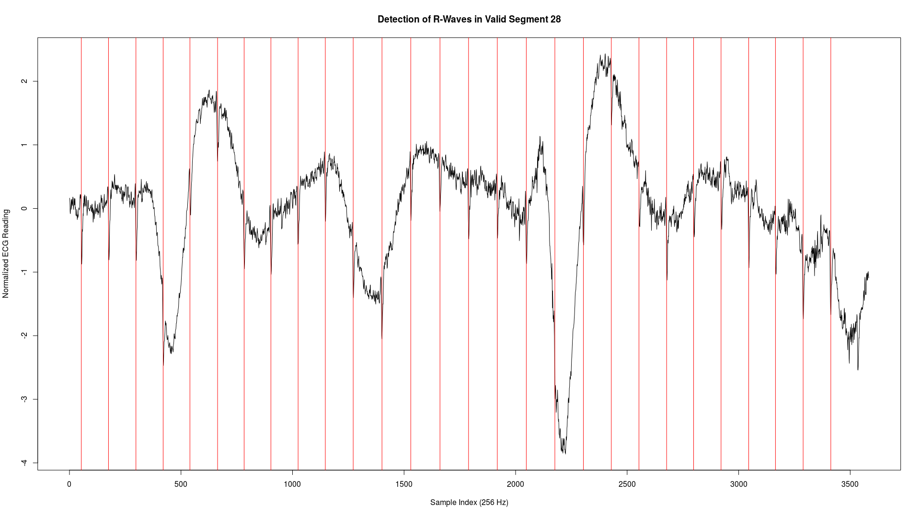
Pan-Tompkins Triggering Errors Consistently early or late and even alternating early/late
Pan-Tompkins
Pan-Tompkins QRS Detect Noisy Data
Del Rey QRS Detect Noisy Data
Early Trigger
Late Trigger
Del Rey
Correct
Correct
Del Rey detects are more consistent in the presence of baseline noise

Slide 9
Pan-Tompkins Shows More False Detects In 12 Seconds Of Noisy Data Than Del Rey
Pan-Tompkins
Double
Triggering
Del Rey QRS Detect Arrhythmia
Del Rey
The Pan-Tompkins predictive detector systematically over-detects in the presence of noise

Slide 10
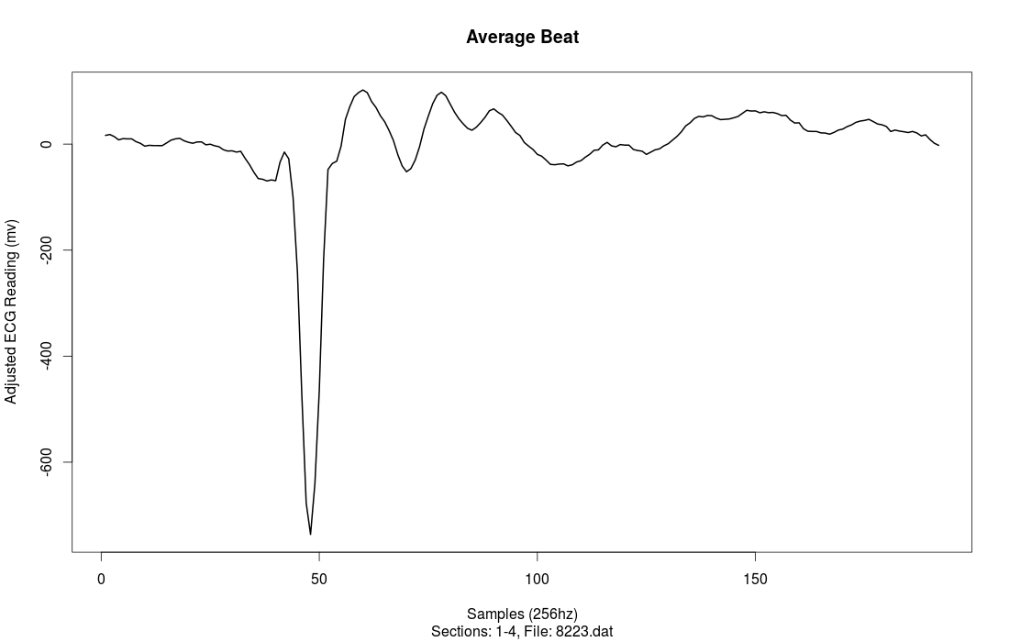
Del Rey Creates An Average Beat
q
S
P
T
Clean average beat
from high noise segments even with reversed polarity
R
Beat averaging is effective, even with fairly bad data

Slide 11
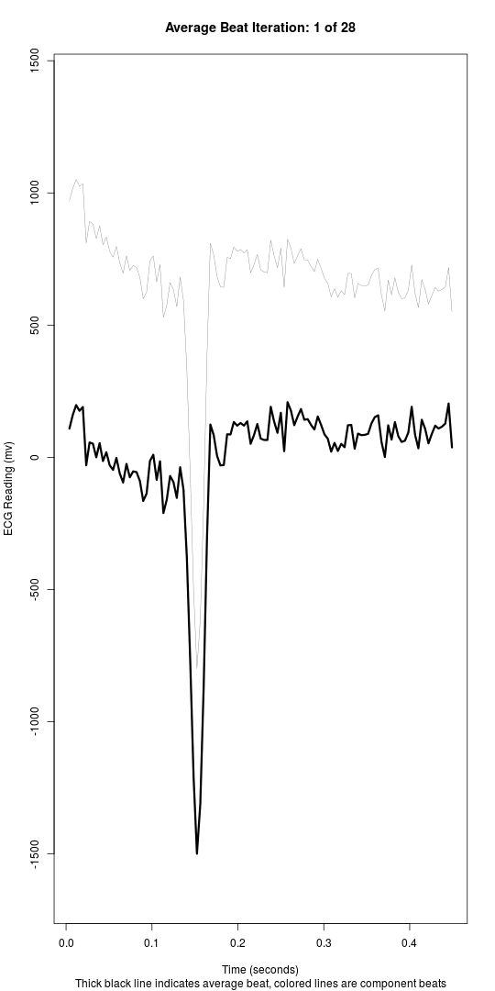
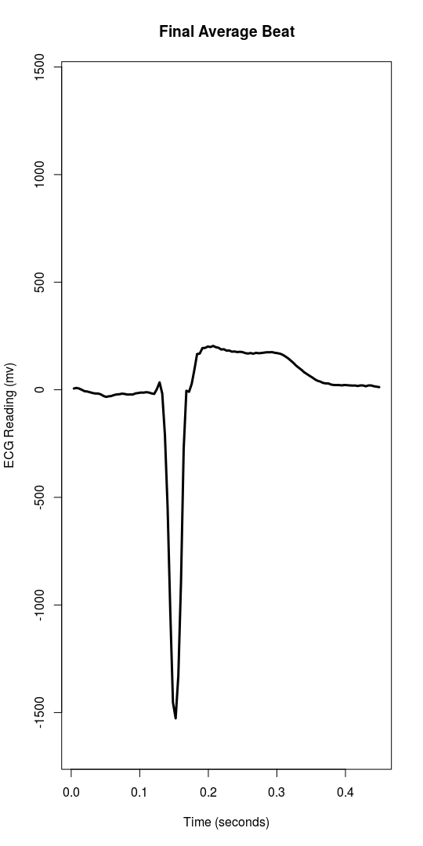
Average Beat Animation

Slide 12
Poincare Plots of HRV
Also known as Lorenz plots or Poincare maps
Help overcome limitations to statistical identification of R-R intervals by using a geometric technique
Plotting successive R-R intervals as a means of visualization of respiratory or other effects
Use sample density histograms of the differences between successive R-R intervals
Help identify and remove incorrect R-R intervals
Too short (ectopic beats)
Too long (sinus or compensatory pauses)
Noise triggering (false detects)

Slide 13
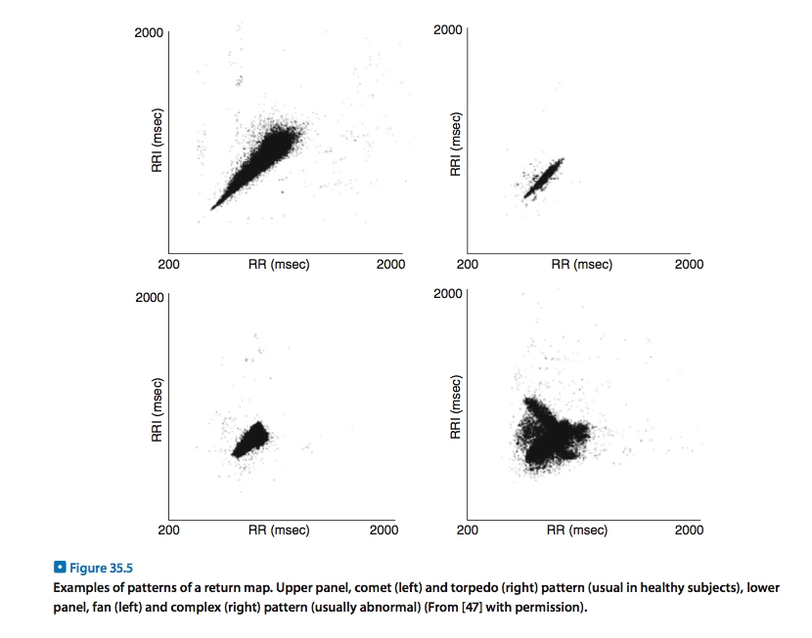
Clinical Significance of Poincare Plots

Slide 14
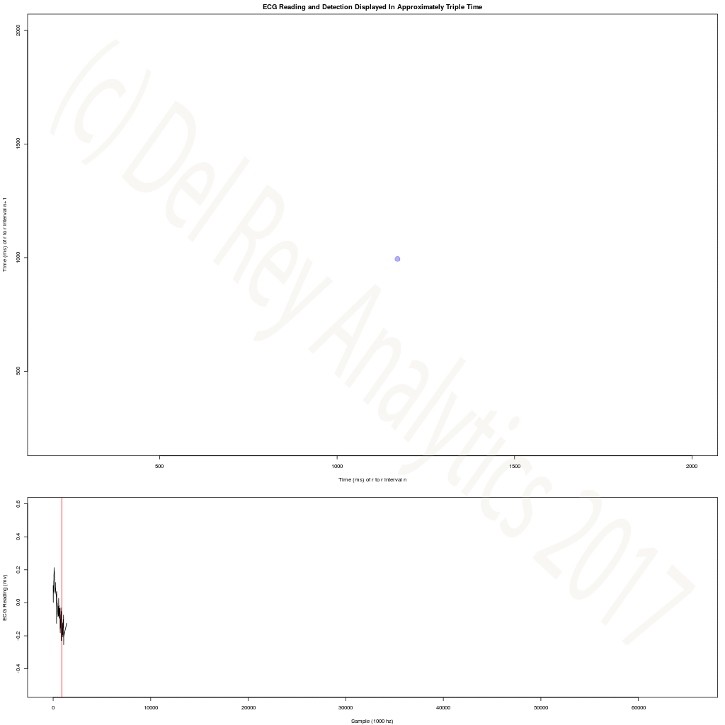
Del Rey Poincare Plot Demo

Slide 15
Del Rey Difference
Goes beyond Pan-Tompkins
Better able to detect QRS in noisy data with many motion artifacts
Better able to reject invalid data
More accurate QRS detection in arrhythmia
Robust estimation of the heart rate and the average beat
More accurate HRV Poincare Plots because of more consistent triggering
Flexible central data frame with segment and beat information in relational model for additional analytics
Runs in open source R, not reliant on commercial product licensing
Deployable on small-footprint processors, such as ARM chip devices

Slide 16
Contact Us
Jean Stanford
jstanford@delreyanalytics.com
301-814-4934 (cell)
From Signal To Knowledge

